Slide 1
Conflict & Humanitarian Status Analysis- Ethiopia
Najwa Saqal
Berlin Dec. 2020

Slide 2
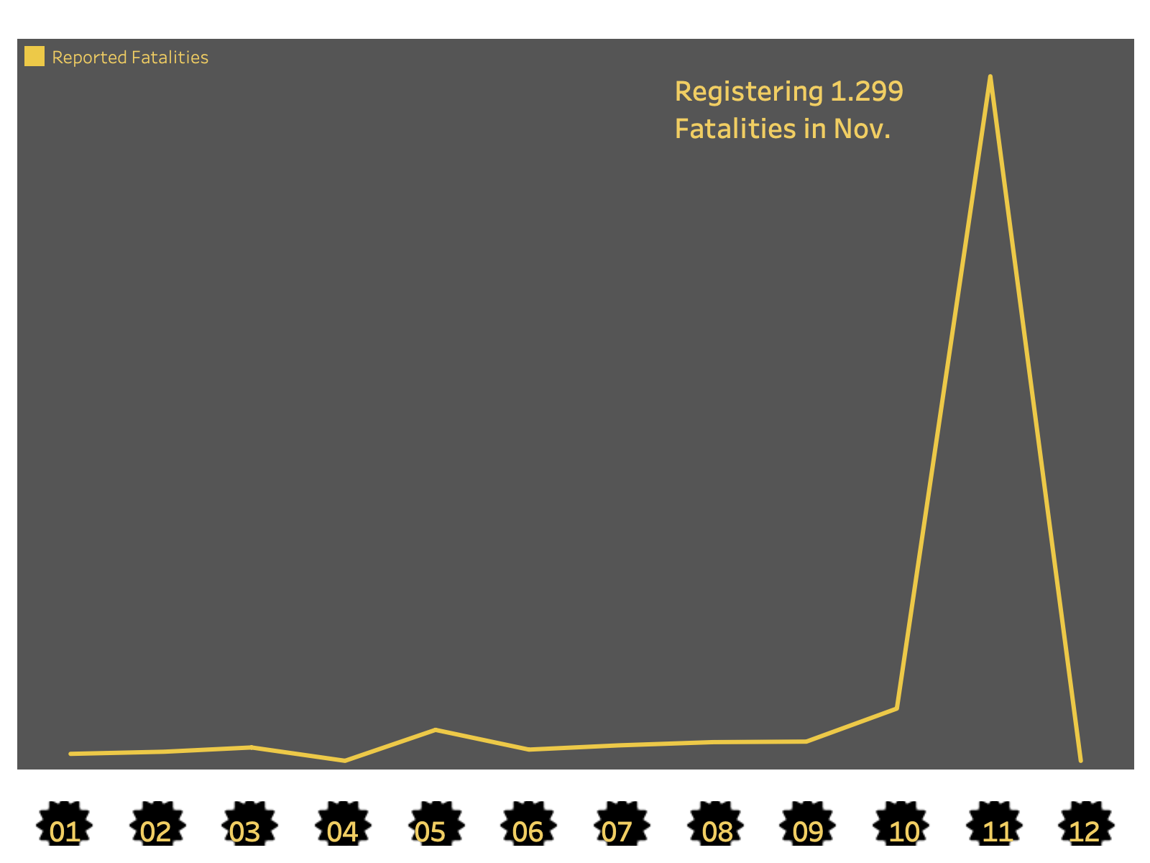
Reported Fatalities in 2020, Ethiopia

Slide 3
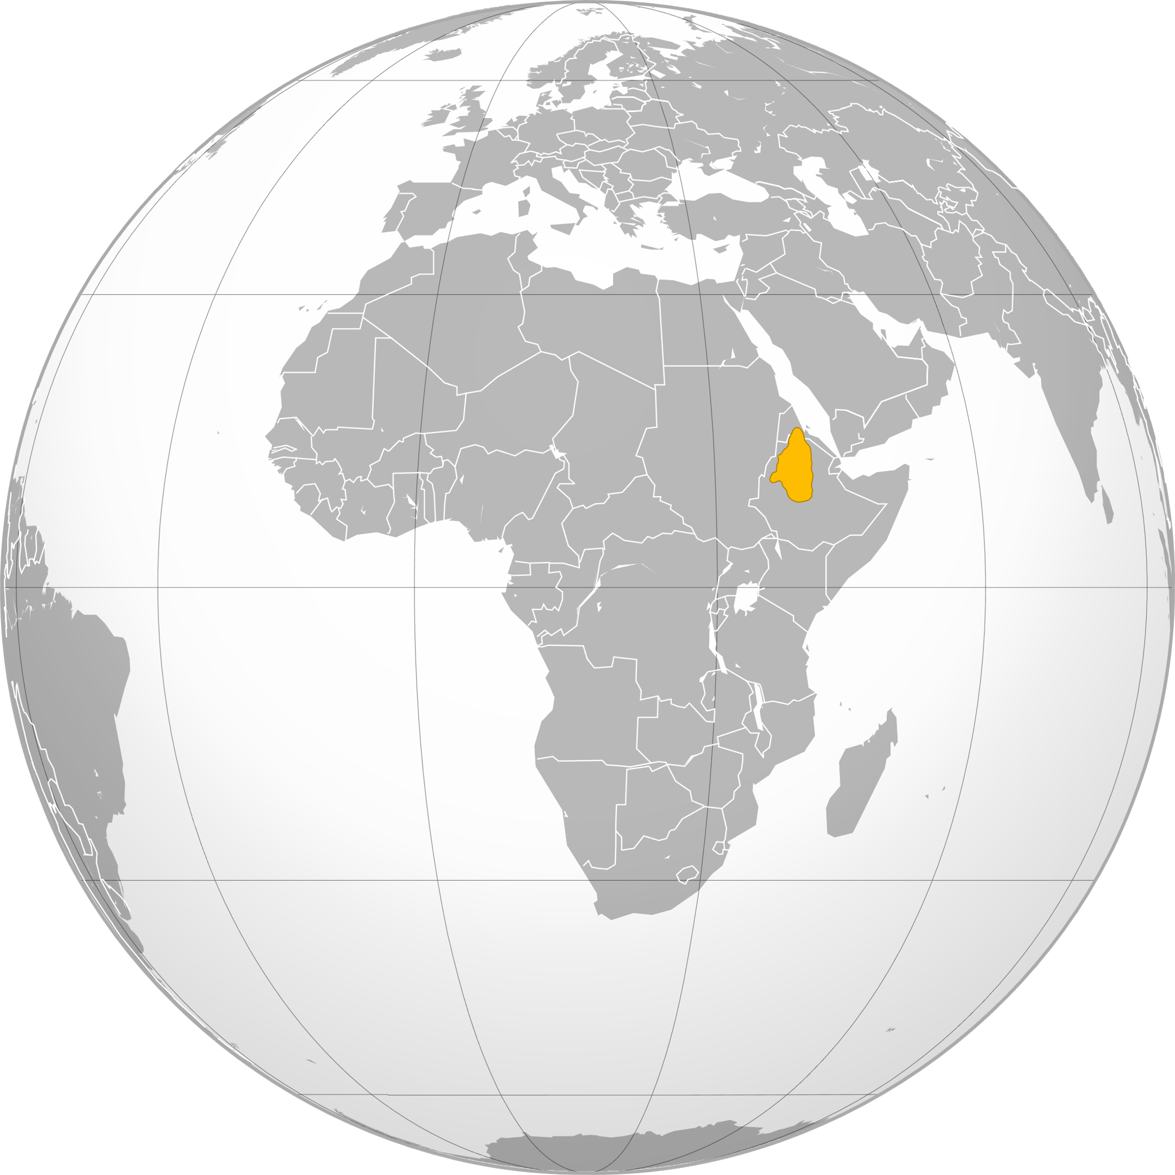

Slide 4
Timeline
Establish the TPLF Party
Abiy Ahmed rules
Covid 19 hits and elections are postponed
Abiy Ahmed responds with counter attacks
Mai Kadra Masscare
1975
04.11
06.11
08 - 09 2020
1991
2018
2018 - 2020
23.11
09.11
TPLF overthrows government
Reforms
TPLF launches an attack
Mai Kadra Masscare

Slide 5
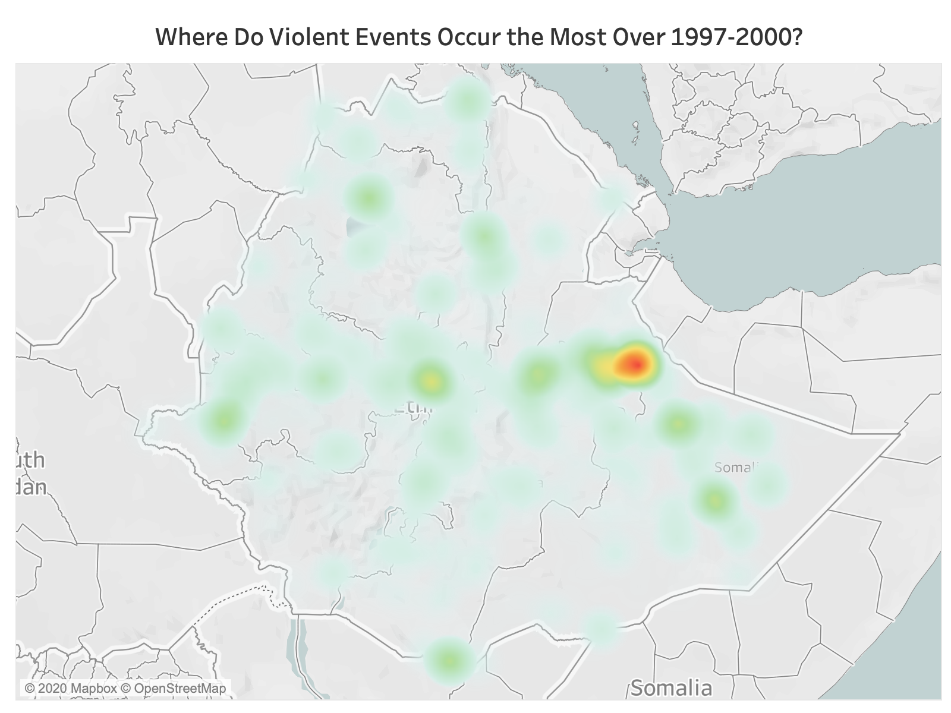

Slide 6
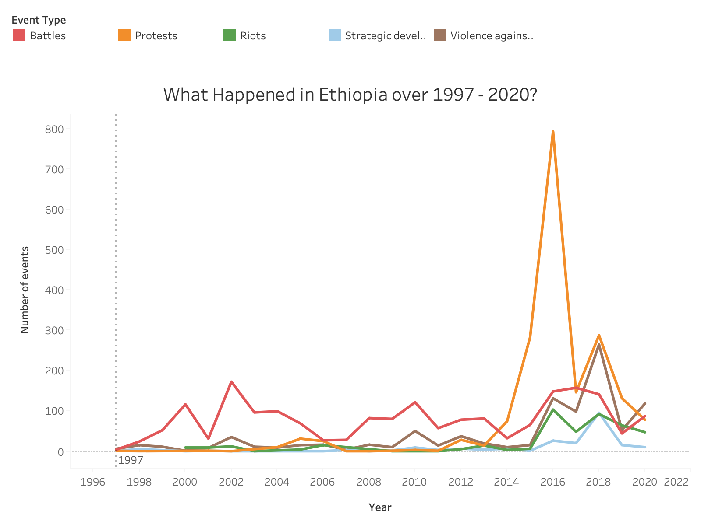

Slide 7
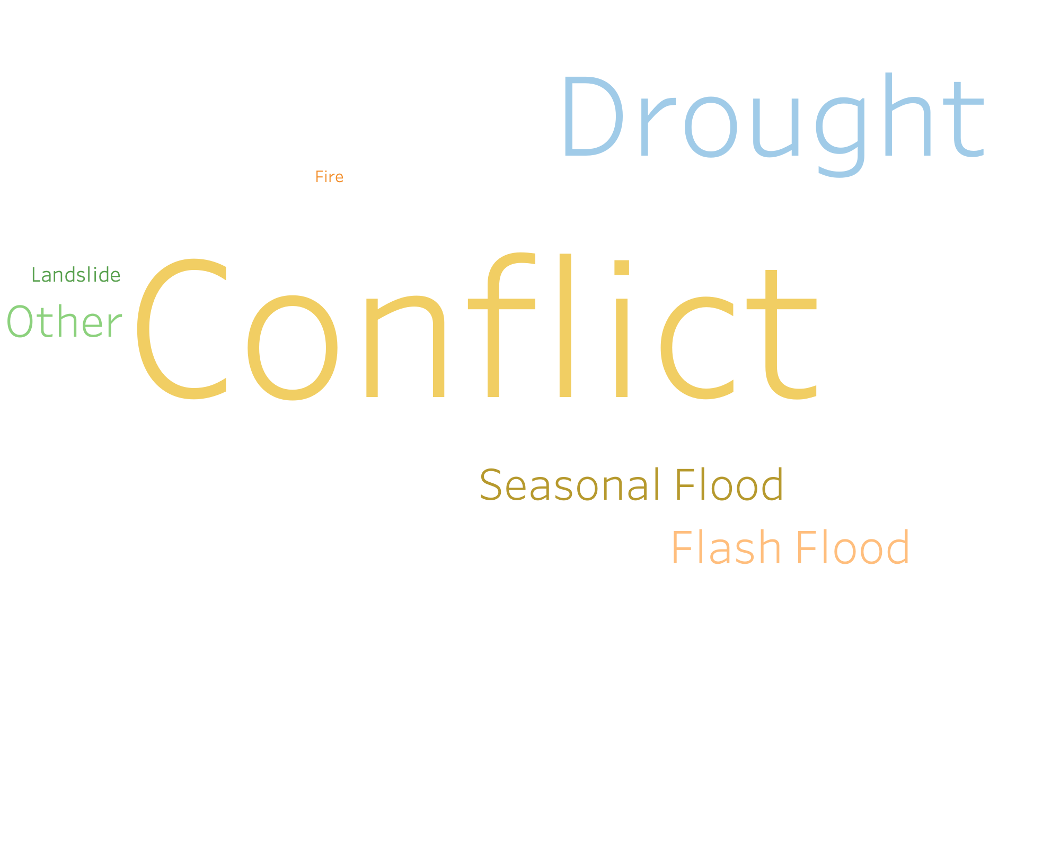
Reasons For Displacement

Slide 8
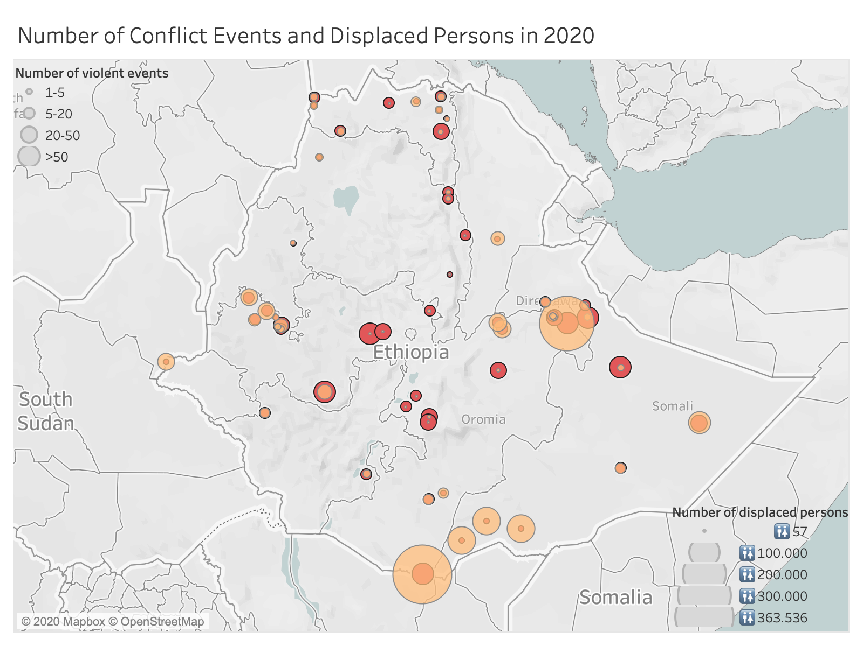

Slide 9
Figures as of Sep. 2020
🚻 1,85 M 🚹 928, 043
🏠 344,782 🚺 918,508

Slide 10
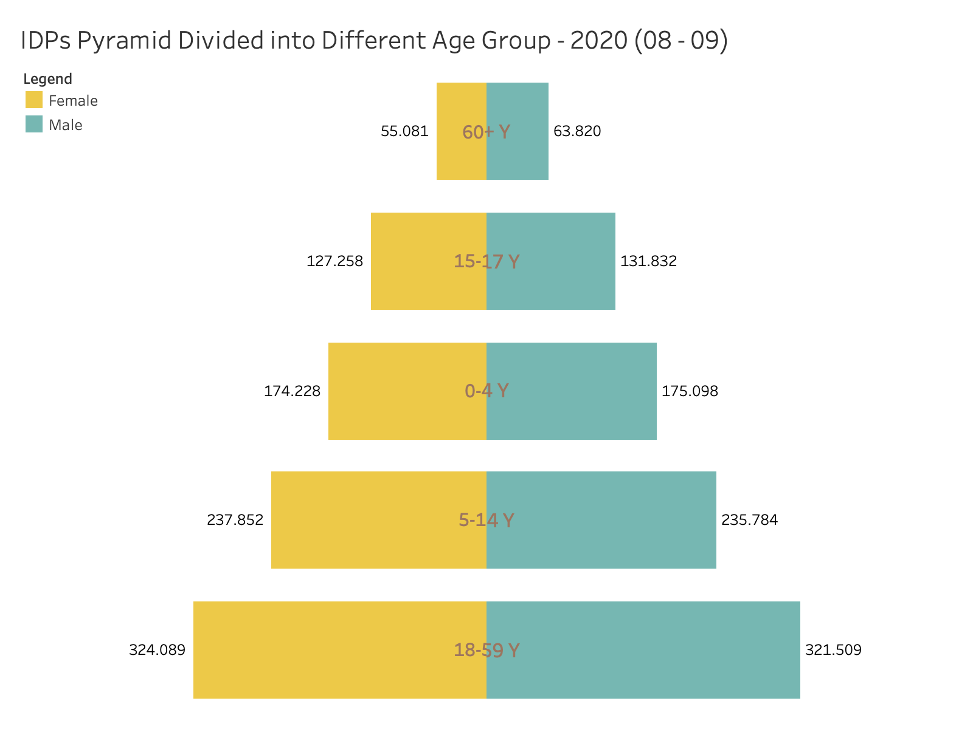

Slide 11
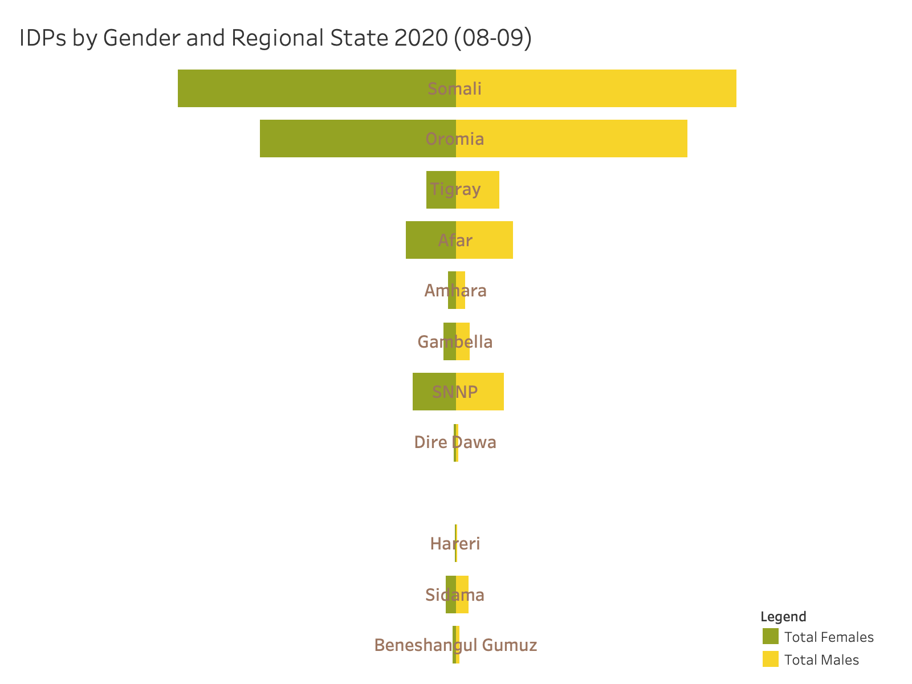

Slide 12
What is next?
Further Analysis
Identifying Gaps
Produce Interactive Dashboard
Up to Date

Slide 13
Thank You!
“All human beings are born free and equal in dignity and rights.”
Article 1, Universal Declaration of Human Rights, UN-General Assembly, December 10, 1948
https://www.linkedin.com/in/najwa-saqal

